Slide 1
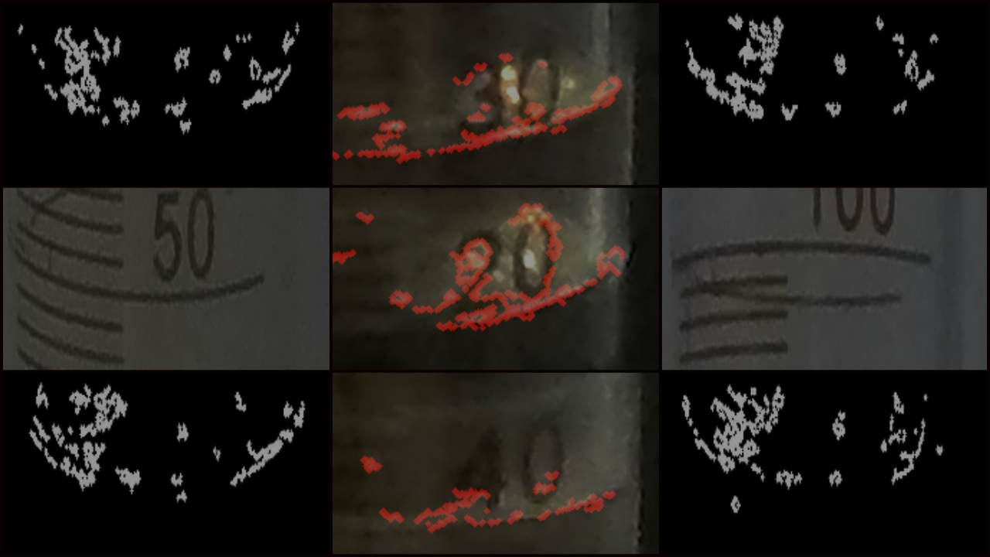
Liquid Level Detection using Caffe CNN in Intel Neural Compute Stick
ECE-696 Independent Project by:
Raghavan Naresh Sarangapani

Slide 2
Contents
GOAL OF THE PROJECT
PROJECT ROADMAP
THE INTEL NEURAL COMPUTE STICK
IMAGE CAPTURE USING GoPro & R-pi
OPENCV PRE-PROCESSING & DATASET
TRAINING & TESTING CAFFE LENET
DEPLOYING NET TO NEURAL STICK
PROJECT DEMO
RESULTS
FUTURE ENHANCEMENTS

Slide 3
Goal of the project
Liquid level detection using OpenCV and Caffe
Portable solution using NCS and R-pi
Improved accuracy in finding liquid level
Analyzing multiple Caffe networks

Slide 4
Project Roadmap
Capture Training images
Crop image to levels
Divide Training & Testing set
Train model using CaffeNet
Deploy model to Neural Stick
Calibrate setup using Raspberry
Grab image from GoPro
Level Detected Output
Intial test setup

Slide 5
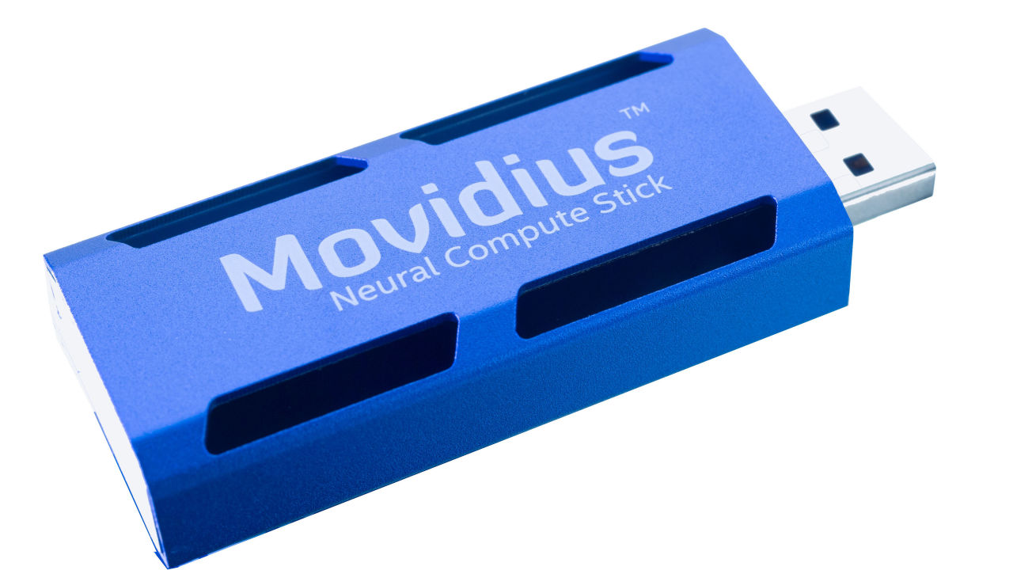
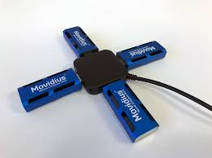
Intel Neural Compute Stick

Slide 6
Beneath the Stick
USB 3.0 design and ability to work with boards like Raspberry pi.
Support for Python and C based code.
Options for multiple sticks to be connected in parallel.
Movidius VPU with parallel processor architecture.
Support for Deploying Caffe based SqueezeNet, GoogleNet and AlexNet.

Slide 7
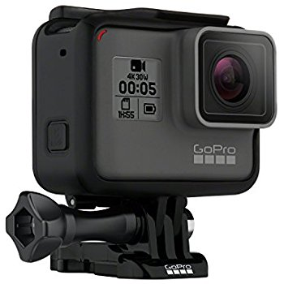
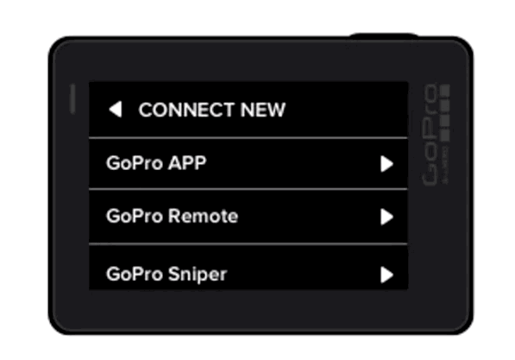
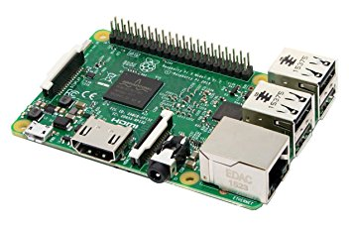

GoPro Hero5 & Raspberry PI

Slide 8
Image capture using GoPro & Rpi
GoPro Hero 5 12 MP Narrow mode image
External LED lighting for better liquid detection
Raspberry Pi 3 connects to GoPro Wi-Fi network
Image transferred using GoPro Py API’s
60 images captured per level, 30 per lighting condition for each level

Slide 9
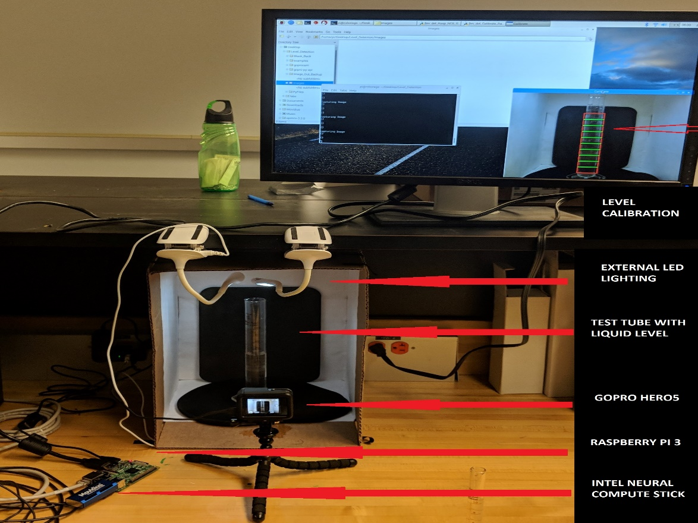
Project Setup

Slide 10


OpenCV
Pre-processing

Slide 11
OpenCV Pre-Processing
Crop test-tube ROI
Convert to GrayScale image
Apply uniform Gaussian Blur
Choose train level image
Choose random non-level image
Adaptive Canny Edge Detector
Draw mid level Horizontal Contours
Organize train and test files
Input Image dim 4000x3000

Slide 12
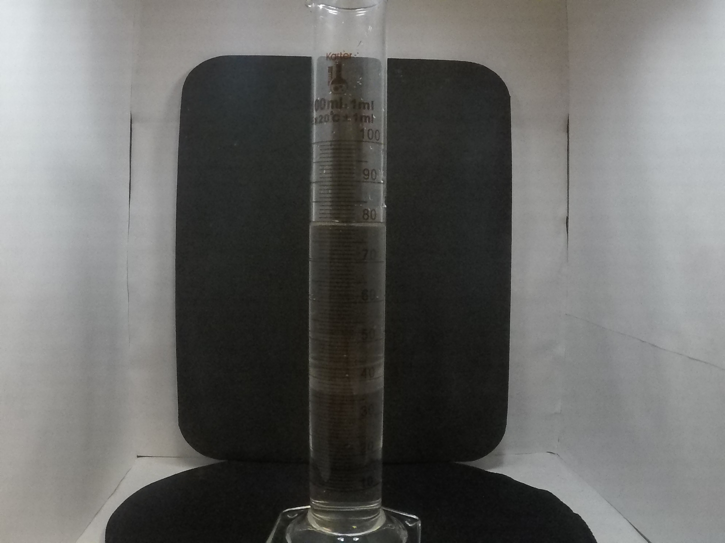
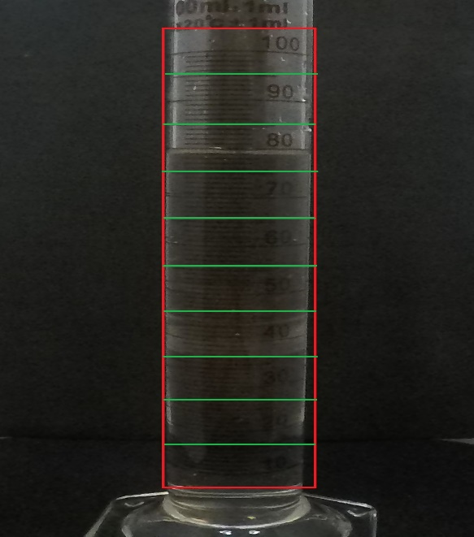
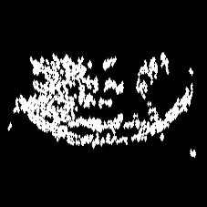
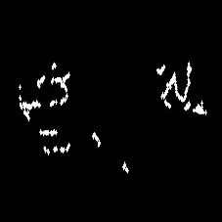
OpenCV proc
Canny Level
Canny Non Level

Slide 13
Dataset Preparation
Total of 600 images captured, 60 per level
Training:Validation ratio- 70:30%, 420:180 img
1 Level image from each Input image, identified from folder name
1 random non-level image per input image
Training set of 840(420L + 420NL) images
Testing set of 360(180L + 180NL) images
All images are ROI based Canny Edge contours

Slide 14
Training & Testing Caffe Lenet
Modified version of Caffe LeNet for better accuracy
Addition of ReLU activation layers for learning more features and Weight drop layer
LMDB file created for training and testing files
Solver set to Gradient Descent model at 10000 iterations
Testing makes use of Deploy Net and trained caffemodel
180 test images used to calculate accuracy

Slide 15
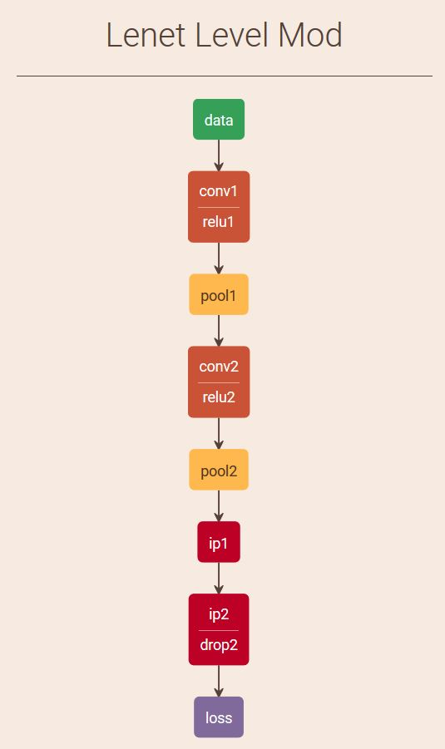
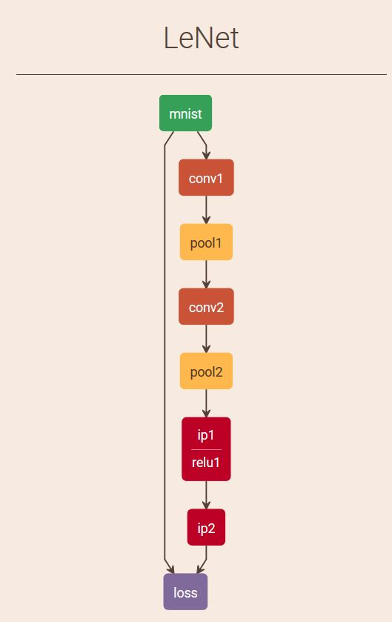
LeNet Train comparison

Slide 16
Deploy Net to NCS
Training of Caffe Network using images.
Caffemodel file and Deploy prototxt files used in profiling
Profiling of trained network using NC SDK
Graph file and processing time analysis generated
Graph file loaded in Neural stick using NC API
Input image given as blob and output level is obtained

Slide 17
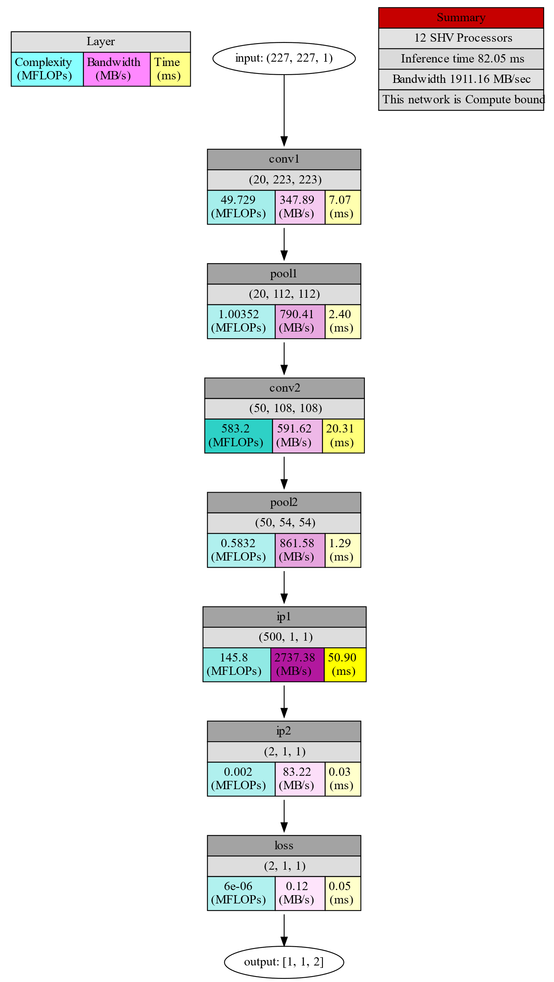
NCSDK Profiling Output

Slide 18

Project Demo

Slide 19
RESULTS

Slide 20
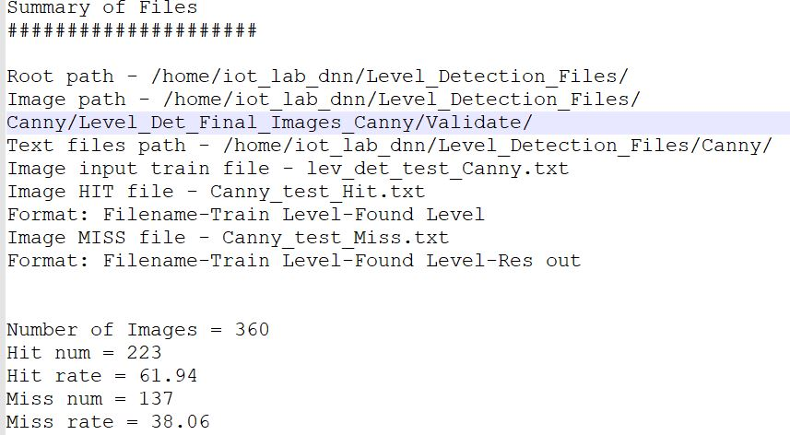
Standalone LeNet Test Image results

Slide 21
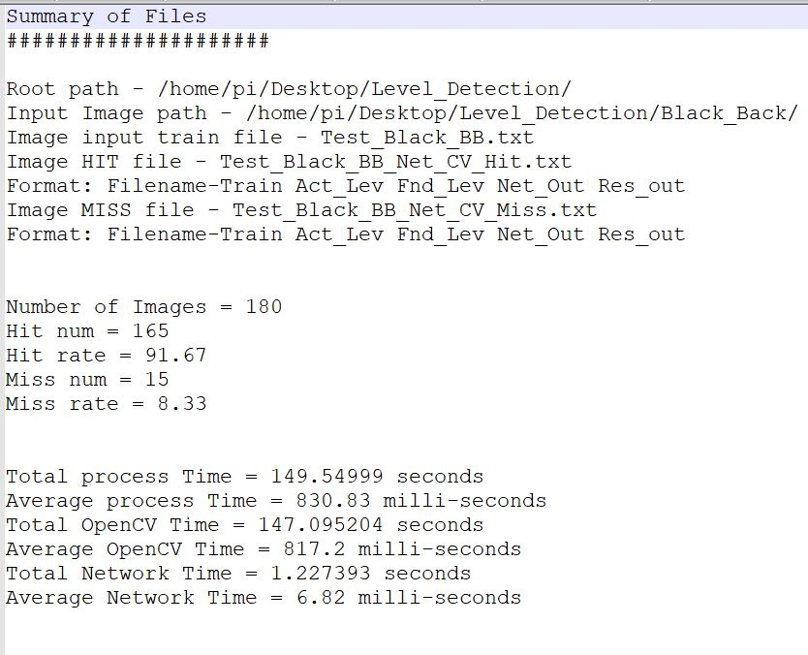
OpenCV + LeNet Test Image results

Slide 22

Thank You

